Slide 1
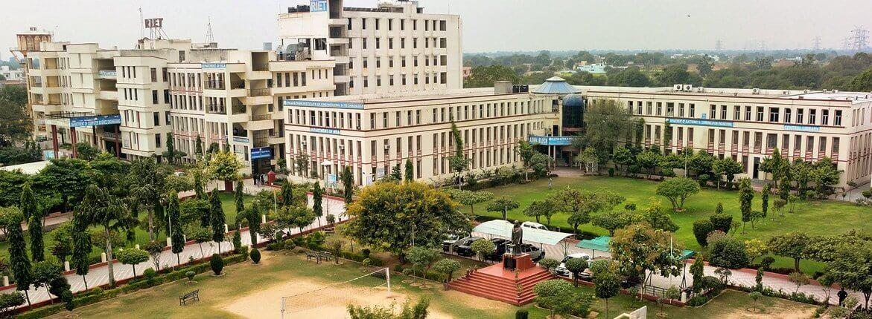
RTU - POORNIMA HACKATHON 2021
TEAM – ANONYTECH
IDEA – IOT BASED VEHICLE PARKING SYSTEM

Slide 2
Contents
Objective
Introduction
Flowchart
Working
Advantages
Application
Conclusion

Slide 3
Objective
The main aim of this project is reduces the risk of finding the parking slots in any parking area.
It eliminates the unnecessary traveling of vehicles across the filled parking slots in a city.

Slide 4
Introduction
Smart Car Parking System is an integrated system to organize cars in public areas.
All vehicles enter into the parking and waste time for searching for parking slot .
Component description
Hardware | Software
Nodemcu | Arduino IDE
ARDUINO UNO | Firebase
IR Sensors
Servo Motors

Slide 5
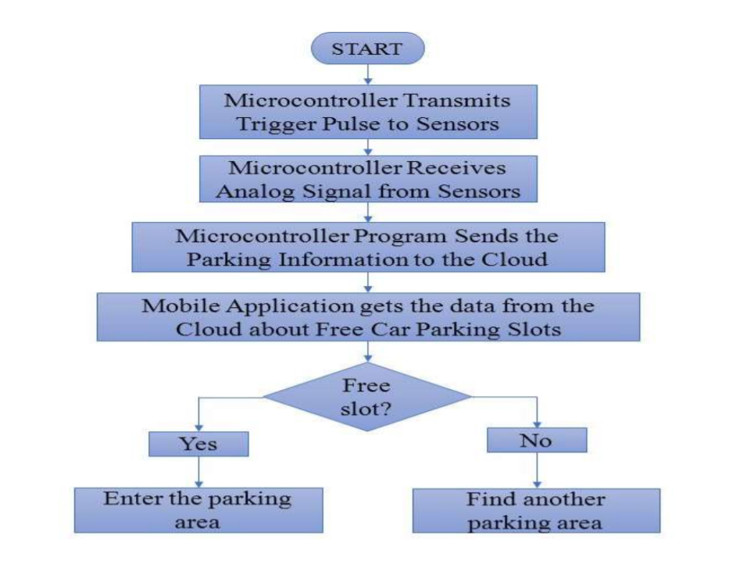
Flow Chart

Slide 6
Advantages
Shorter waiting time at parking place.
It saves fuel, money, space and time.
Reduced pollution.
Reduced traffic.
Carbon emission is reduced.
Efficiency
Applications
The smart car parking system can be implemented in …
• Shopping malls
• Restaurants
• Theatres

Slide 7
Conclusion
This project focuses on implementation of car parking place detection using Internet of Things.
The system benefits of smart parking go well beyond avoiding time wasting.
Developing a smart parking solutions with in a city solves the pollution problem.

